Slide 1
Learning to cooperate or “How I became a good neighbor”
Milos Rovcanin

Slide 2
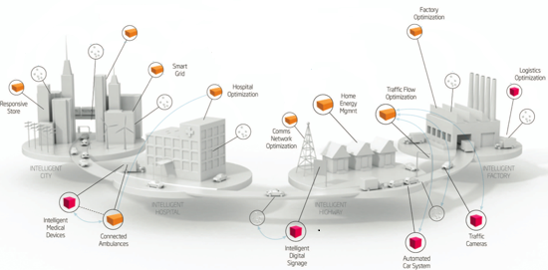
Status quo
Enormous increase in a density of co-located, multi-purpose networks.

Slide 3
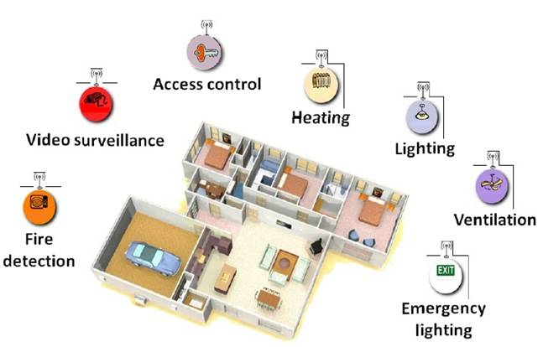
Zooming in
Pretty soon, a typical household unit will be equipped with a number of
wireless networks, for all sorts of purposes: controlling temperature,
access to premises, temperature, ventilation etc.

Slide 4
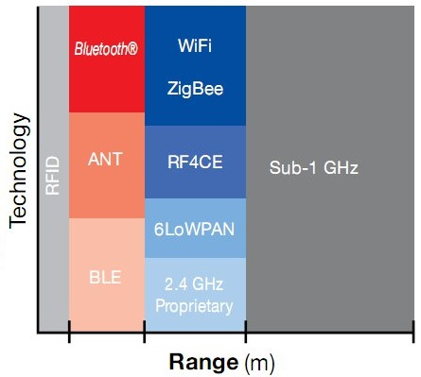
Network diversity
A huge variety of network preferences and their hardware/software capabilities:
Wifi standards IEEE 802.11a, 802.11b, 802.11g and 802.11n (at 2.4 GHz)
Zigbee standard IEEE 802.15.4 (at 2.4 GHz)
6LoWPAN (RFC 4944) standard IEEE 802.15.4 (at 2.4 GHz)
ONE-NET is an open-source standard for designed for low-cost, low-power control networks
Bluetooth standard 802.15.1 (2.4 up to 2.8 GHz)
Bluetooth Low Energy (Wibree) is a subset to Bluetooth V4.0 with an entirely new protocol stack for rapid build-up of simple links.
ANT: ANT is a proprietary wireless sensor network technology operating at 2.4 GHz that provides a low-cost and ultra-low power solution for short-range wireless communication in point-to-point and more complex network topologies
Source: Texas Instruments Wireless Connectivity

Slide 5
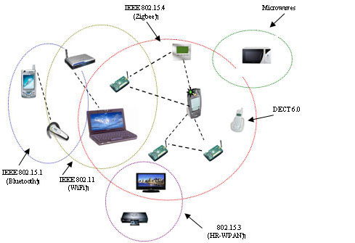
Sharing a common radio frequency
Communication interference is commonplace:
Interference avoidance as a basic form of inter-network cooperation

Slide 6
The starting point
Static grouping of mobile devices is complex, inefficient and might lead to a waste of resources
Network solutions that dynamically support at run-time cooperation between devices from different types of networks are becoming a necessity.

Slide 7
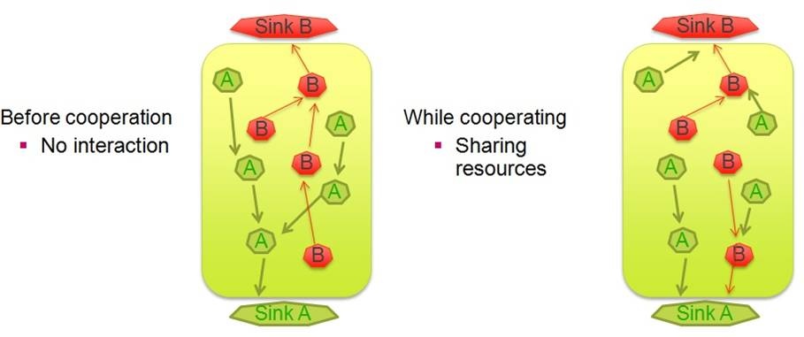
Networks cooperating

Slide 8
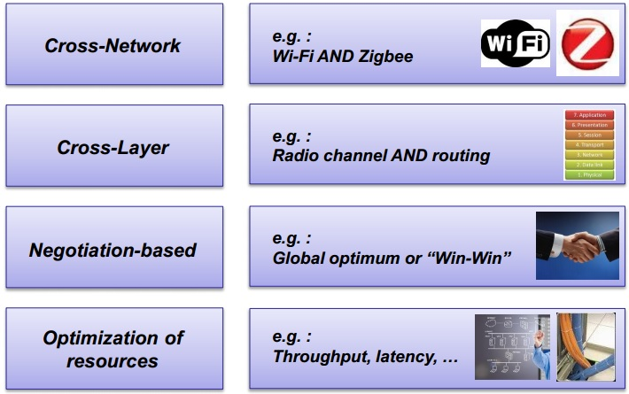
Incentive driven networking
A cross-layer, cross-network negotiation methodology for optimizing network resources

Slide 9
Incentive driven networking
Incentive describes a high-level network behavior or a reason for cooperation:
Describe behavioral aspects of the network
Express the need for additional functionality
Give an indication of the expected performance network metric
Examples:
High throughput, high reliability, low delay (better QoS)
High network lifetime
High coverage
Low exposure
Public access

Slide 10
Network services
Whereas incentives indicate network goals, network services are means to realize these goals
Network services should be understood as optimization techniques that have influence over one or more incentives
Examples:
packet aggregation and sharing, MAC protocols, interference avoidance techniques …

Slide 11
Activating network services has (positive or negative) influence not only in a network where the service is activated.
By carefully choosing which service to activate, networks can improve not only their own, but the neighboring network’s performance as well.

Slide 12
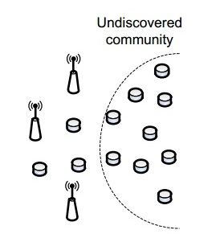
Incentive driven networking
Step 1:
Devices dynamically search for co-located devices with similar network preferences and hardware and/or software capabilities

Slide 13
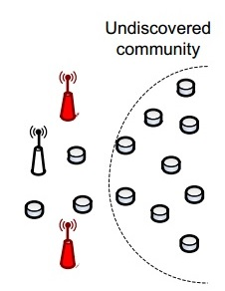
Incentive driven networking
Step 2:
If such devices are found, communities consisting of interconnected objects with similar network expectations are formed on an ad hoc basis

Slide 14
Incentive driven networking
Step 3:
Different communities will now able to cooperate with each other by activating and sharing (software or hardware) network resources.

Slide 15
The major issue
How to efficiently determine the optimal configuration parameters for all the participating networks, considering their high level goals and ensuring that the cooperation in mutually beneficial?

Slide 16
A self learning approach
There is a need for a reasoning entity that will initiate and control the cooperation process.
It will use certain performance metric to make an assessment of every relevant and utilized service combination, over an entire symbiotic network.
It must be able to automatically reconfigure all the participating networks, depending on a decision it makes.

Slide 17
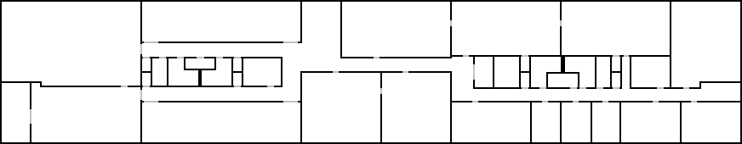
A self learning approach – use case
Final goal: three-tiered approach
Phase 1: Optimization of service settings (in-layer)
Phase 2: Selection of optimal service sets (cross-layer)
Phase 3: Cross-network negotiation (cross-network)
Also take into account the requirements of co-located networks
The goal:
Determine the best combinations of network services
B
A
B
A
B
B
A
B
A
B
A
A
A
B
A
Sink B
B
A
B
Sink A
A
Temperature sensor node (community A)
B
Intrusion detection sensor node (community B)

Slide 18
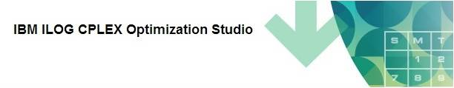
The initial approach
Linear programming (LP)
Negotiation entity (NE) collects network’s service profiles and “calculates” the optimal service set for every sub-net using an IBM’s linear programming engine

Slide 19
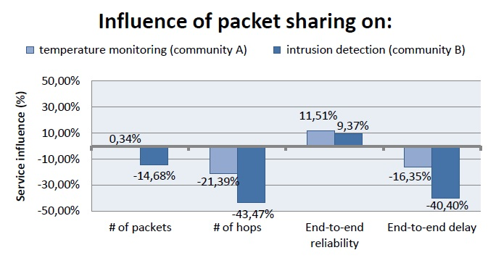
Disadvantages
Requires a priori knowledge - fixed benefits and costs for activating each service:
Eli de Poorter, Pieter Becue, Milos Rovcanin, ingrid Moerman, Piet Demeester, “A negotiation-based networking methodology to enable cooperation across heterogeneous co-located networks”

Slide 20
Disadvantages
Information about the service influences is extremely difficult to obtain:
Simulation
From a literature
Assumed …
Most of this data relates to static networking cases and change drastically when some of the network parameters change.
Conclusion:
ILP solver is a poor solution for dynamic environments

Slide 21
Possible alternatives
More adaptable to environments with fast changing parameters and much less demanding when it comes to a priory input information
Simulators
Mathematical modeling
Game theory
Machine – reinforcement learning

Slide 22
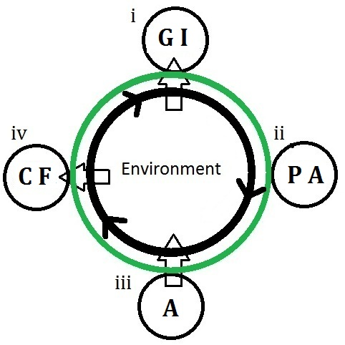
Cognition cycle
4-steps:
Gathering Information (GI)
Planning Actions (PA)
Act (A)
Collecting Feedback

Slide 23

Reinforcement learning
Modeled as a Markov decision process (MDP)
A decision maker goes through states: S = {S1, S2, … , S3}
Taking one of the available actions A = {a1, a2,… aN} at each step
The Bellman equation describes the learning process:
At each step, take the action that will maximize Q-value for the given state/action pair

Slide 24



Reinforcement learning
Bellman equation:
- Immediate reward
expected future reward
state transition probability

Slide 25


Least Squares Policy Iteration - LSPI
First Introduced in:
M. Lagoudakis and R. Parr. “Model-free least-squares policy iteration”. In Proc. of NIPS, 2001.
Approximates Q-function with a linear representation:
- basis functions represent a network’s feature (e.g., residual energy of s’, link quality between s and s’ etc.)
- a corresponding weight factor

